Slide 1
“Paris compatible” governance: insights from climate law case studies
Matthias Duwe, Ecologic Institute
Real Instituto Elcano
04 December 2017

Slide 2
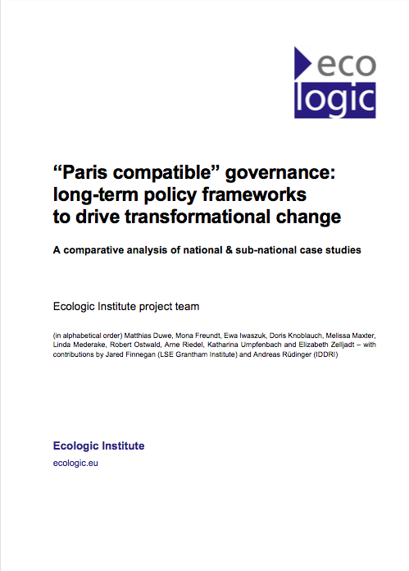
Report on climate laws case studies
Paris: a new governance consensus
Evidence base is not strong so far
Enhance understanding of what works
Part of larger research effort (IDDRI, Grantham Institute)
Funding from European Climate Foundation (ECF)

Slide 3
What we have done
 | Level | Case study | Geography
1 | National | France ** | Europe
2 | National | Germany | Europe
3 | National | Ireland | Europe
4 | National | Mexico | Central America
5 | National | Sweden | Europe
6 | National | United Kingdom ** | Europe
7 | Sub-national | California, USA | North America
8 | Sub-national | Scotland, UK | Europe
9 | Sub-national / city | Berlin, Germany | Europe
10 | City | Bogota, Colombia | Latin America
11 | City | Denver, USA | North America
12 | City | Kempten, Germany | Europe
13 | City | Sydney, Australia | Pacific

Slide 4
What we have done

Slide 5
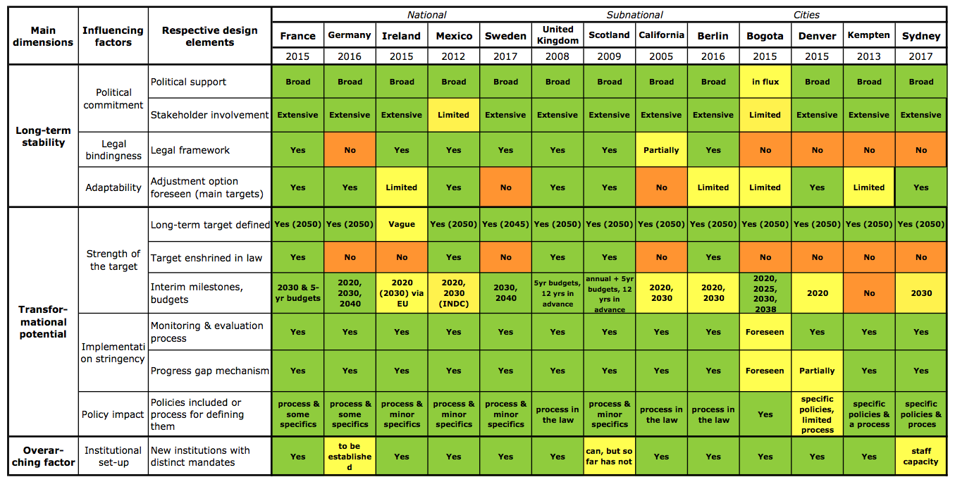
Results…

Slide 6
Momentum:
governments aiming to implement Paris
turn to long-term framework laws
…you are in good company!
In Europe: UK, Scotland, Ireland, France, Sweden, Norway, Finland, Netherlands…
(not: Germany)

Slide 7
Legal power:
frameworks enshrined in law
can more effectively drive transformation
Signal of direction and commitment.
Do go for a law – it does make a difference!

Slide 8
Political commitment:
even laws need support, before and after –
can be built into the design - across parties
+
Stakeholder ownership key for success
and needs dedicatedeffort to be achieved

Slide 9
Governance innovations – key features
Mind the gap, “Paris style”:
progress monitoring coupled with policy reviews
+ specific provision to review the target, raise ambition
Roadmaps to the future:
short-term decisions must serve the transformation
External advice:
dedicated institutions can provide
expertise & transparency, need capacity!

Slide 10
Many innovative design elements:
carbon budgets
citizen engagement
climate justice
link to budgetary/fiscal policies

Slide 12
Thank You for Listening!

