Slide 1




Policy mixing for sustainable resource use
Conceptual reflections from participatory policy mix design and scientific assessment
Dr. Martin Hirschnitz-Garbers* and Ullrich Lorenz**
* Ecologic Institute, Berlin, Germany, martin.hirschnitz-garbers@ecologic.eu
** German Environment Agency, Dessau, Germany, ullrich.lorenz@uba.de
“Models, Potentials and Long-Term Scenarios for Resource Efficiency (SimRess)” – supported
under the German Environment Agency’s UFOPLAN programme. (FKZ 3712 93 102)
Notes:
Slide 1:
• Title of the presentation
• Authorship of the persons involved (the speaker’s name should be underlined)
• Affiliations of the authors, and contact address
• Acknowledgements (they can be also presented in the last slide)

Slide 2
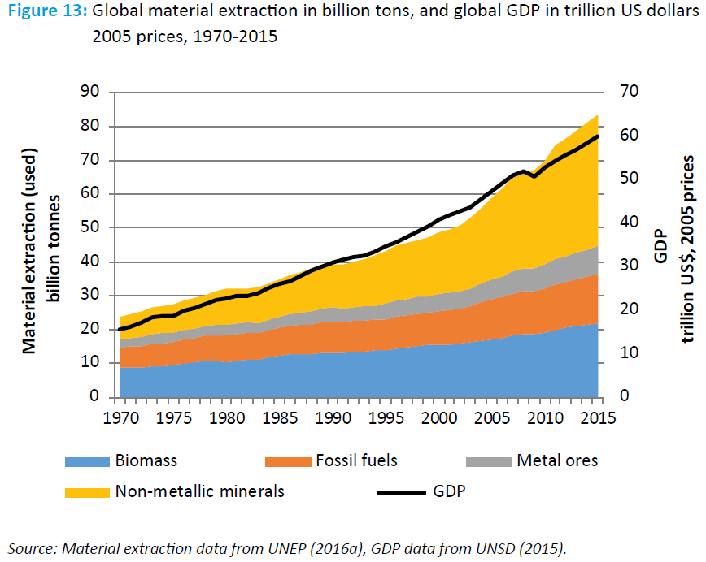
Policy mixing in resource policy – promise or misfit?
Resource use trends – global and national – indicate the need to tackle complex economic and behaviour patterns
  Could the concept of policy
  mixing provide a solution?
  How to design and how to
  assess policy mixes?
  What are lessons learnt in a
  research project context?
Source: UNEP 2017, p. 58
Notes:
• Introduction to the topic addressed and motivation for the work
• Definition of questions and problems tackled in the study
UNEP (2017) Resource Efficiency: Potential and Economic Implications. A report of the International Resource Panel. Ekins, P., Hughes, N., et al., p. 58

Slide 3
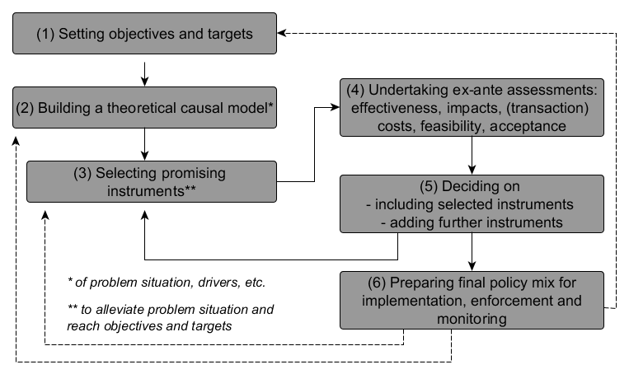
The concept of policy mixing as a solution?
What is policy mixing?
  Policy making 2.0/…?
  Old wine in new skins?
  ≠ Policy layering
  A Challenge to policy making!
Why a challenge?
  Long-term perspective
  Need for coalition building beyond legislative periods
  Forward-looking assessments meeting political realities
Source: Ekvall et al. 2016; adapted from Givoni et al. 2013
Notes:
Content with the core of your work: information about how you have performed the study and major results.
The concept of policy mixing may be an answer to this call. While applied in environmental policy in various contexts, policy mixes seem mostly designed by adding instruments, often without considering potential interactions and consistency. In the context of a German research project we tested the theoretical concept of policy mixing through participatory policy mix development, aided by causal loop diagrams, and model-based ex-ante assessments.
Theoretically, the concept requires to link long-term and short-term objectives to a set of carefully selected instruments, aiming to maximise synergies and minimise trade-offs between instruments. Designing and implementing a policy mix hence requires a long-term forward-looking roadmapping process and knowledge about the mix’ potential effects. This challenges scientific assessment and practical design and implementation of policy mixes.
Robustly assessing cumulative impacts of sequentially linked policy instruments is very demanding in terms of conceptual and computing power of those undertaking scientific assessment. Furthermore, scientific findings will always come with a degree of uncertainty, which good scientific practice demands being communicated transparently, while policy making typically calls for concrete proposals with (near) certainty. Hence, in the final decision making by democratically elected institutions, decision-makers must weigh different sources of knowledge and different options against each other in the context of political and socio-economic feasibility. This necessitates skills and capacities among decision-makers which do not thrive in a prevailing political economy of maximising chances to maintain power from one election term to the next – as this rewards short-termism and a focus on immediate benefits while discouraging long-term thinking with more distant benefits.

Slide 4
The concept of policy mixing as a solution?
How the study was performed
  Relating to objectives/targets
  Theoretical causal model
    Causal-Loop-Diagrams
  Selecting promising instruments
    Inventorised & combined instruments
    Discussing with officials
    Recovering from decisions
  Undertaking ex-ante assessments
    Translating policy strategies into simulation models
    Assessing environmental and socio-economic impacts of policy strategies
Source: Koca 2015
Notes:
Content with the core of your work: information about how you have performed the study and major results.
CLDs to identify intervention points
Inventorising and combining instruments through matrix solutions, working paper
Discussing with officials in Fachgespräch November 2015

Slide 5
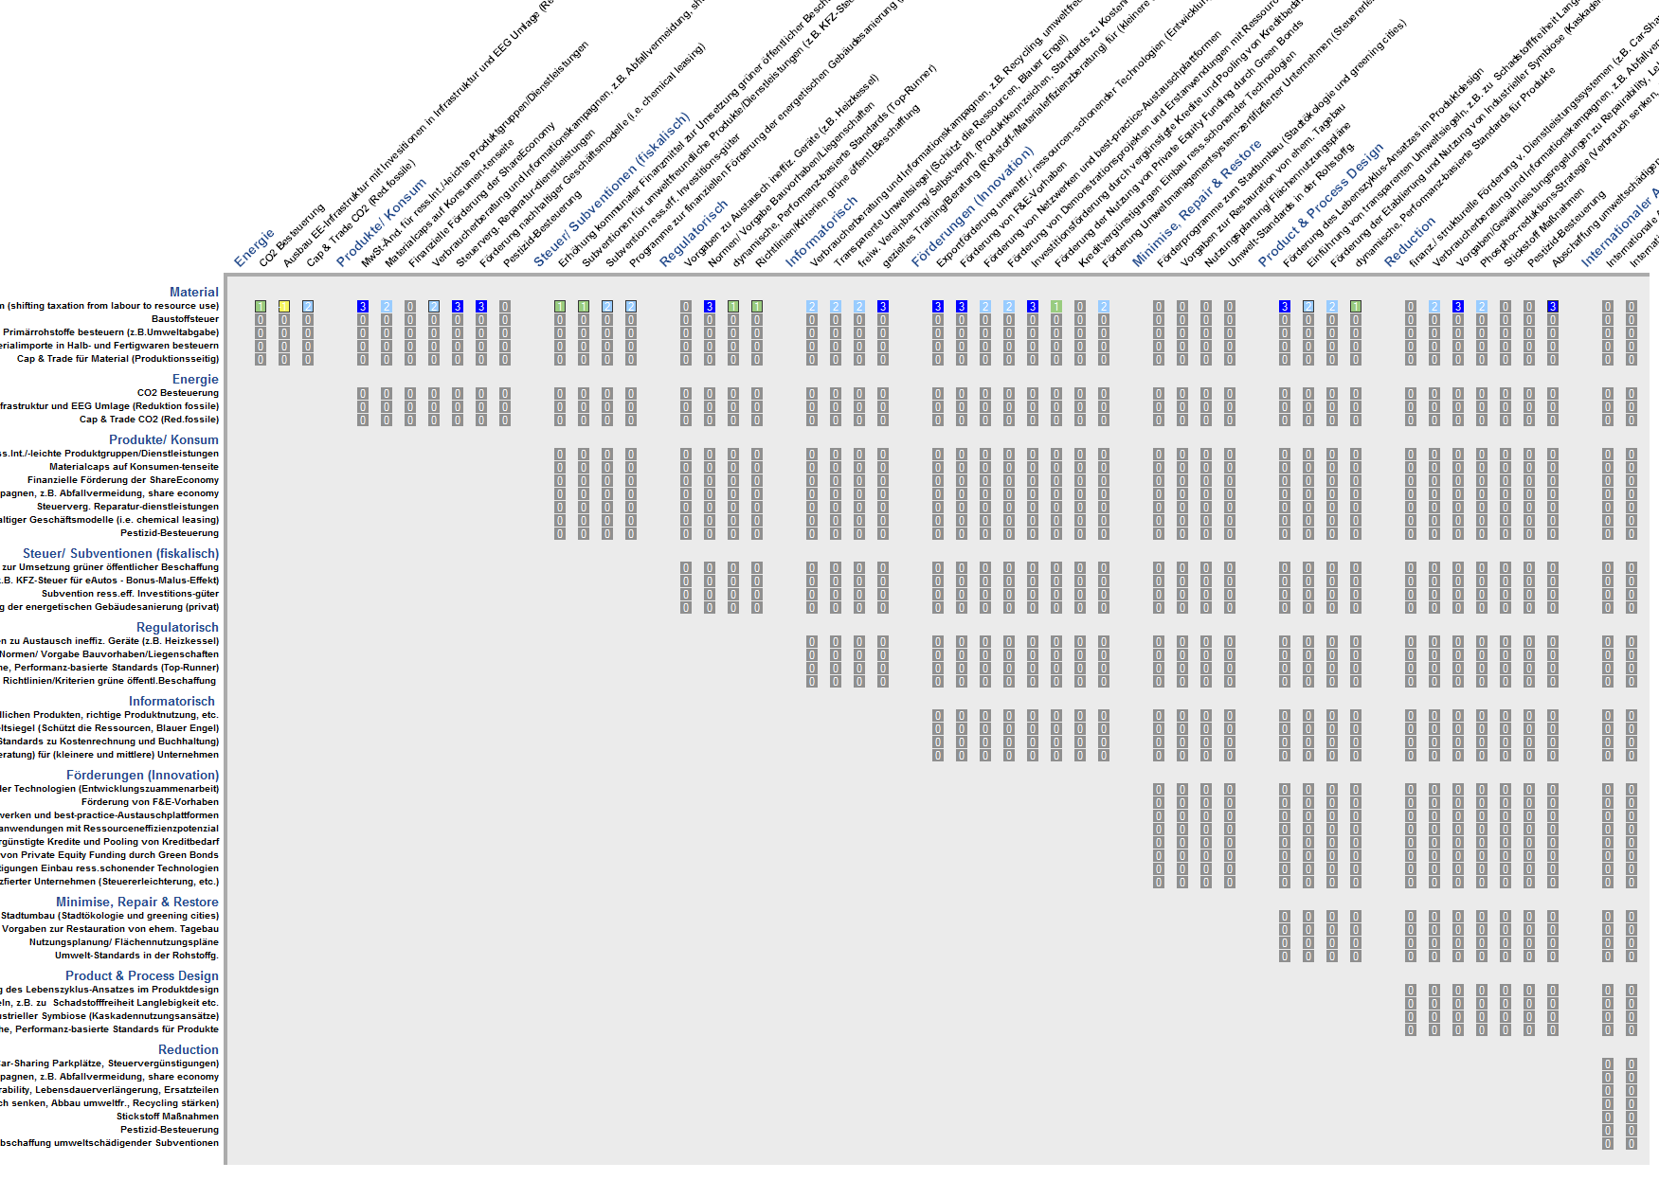
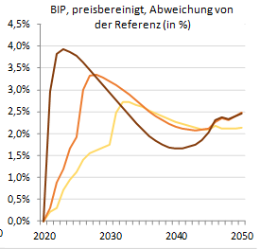
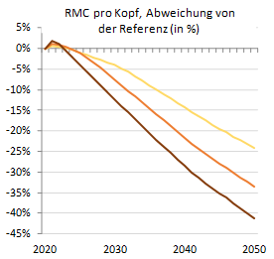
Challenges for policy mix design and assessment
Scientific inquiry vs. policy relevance?
  Detailed conceptualisation mismatching
  steering group interest
  Orientation towards national
  programme and feasibility ≠ ambition?
Scientific assessment of
cumulative effects?
  Assuming and parametrising
  cumulative effects
  Time dynamic policy mix effects –
  roadmapping
Source: Bergmann 2015
Notes:
Content with the core of your work: information about how you have performed the study and major results.

Slide 6
Conclusions – Policy mixing far away from practice?
Very promising, but with design and assessment issues
  Design strongly depends on who is asked to draft (a) mix(es)
    Ambition vs. feasibility / detail vs. speed /
  Assessment needs clarity on scientific and/or heuristic (policy makers)
  Foster models’ and modellers’ capacities to assess cumulative effects
As well as with practical implementation issues
  Political realities neither aligned with long term policy mix implementation, nor with sticking to any initially developed mix
  Policy makers’ skills not aligned with long term policy mix implementation
  => organisational theory and political economy research needed
Notes:
Conclusions and recommendations.
Policy mixes promising, but needs …; research issue for simulation of cumulative effects; skilling policy makers
Looking at potential effects of policy mixes on target groups, including potential synergies and trade-offs between policy mix instruments or policy mix objectives, in a constantly changing context of power relations, relevant actors and possible coalitions makes the concept of policy mixing a very complex and hence very challenging task for policy preparatory and policy makers (del Rio and Howlett 2013; Karoline S. Rogge and Reichardt 2016; Minogue 2002). Adding the need for long-term views and hence for coalition building for implementing long-term policy mix objectives further complicates this process and may make it appear insurmountable – maybe due to current political practices rendering policy mixing a risk for political survival, and having yielded skills unfit for tackling policy mixing.
Therefore, albeit a promising concept to improve systems thinking and long-term views in resource policy, policy mixing is met with formidable challenges, which need to be better understood in order to increase the applicability of policy mixing for systemic resource policy. Further research from organisational theory and political economy may help shed light on circumstances under which such strategic policy-making would be possible and through which skills and actions its feasibility could be strengthened.

